Slide 1
JOURNEY PPT
Custom IDA
29 Aug – 01 Sept
- Musaddiq Shariff

Slide 2
Day -1: Introduction to Business Intelligence
Introduction to DBMS, Basics of DBMS, Normalization and Denormalization
Understanding KRA( Key Resource Area) and KPI( Key Performance Indicator)
Components of Business Intelligence – Dimensional modeling, Data Warehousing, Data Mining was explained
Many real time examples were given to understand each of the components
Explained OLTP and OLAP in detail
ETL (Extract Transform Load) tool – What ?
Examples of ETL and its importance was explained

Slide 3
Day 2: Dimensional Modeling
Explained the basics of Dimensional modeling
The logical design technique that seeks to present the data in a standard framework that is intuitive and allows for a high-performance access.
Understanding FACTS, fact table and dimensional table
Creating Library management fact table
Understanding about Slicing and Dicing

Slide 4
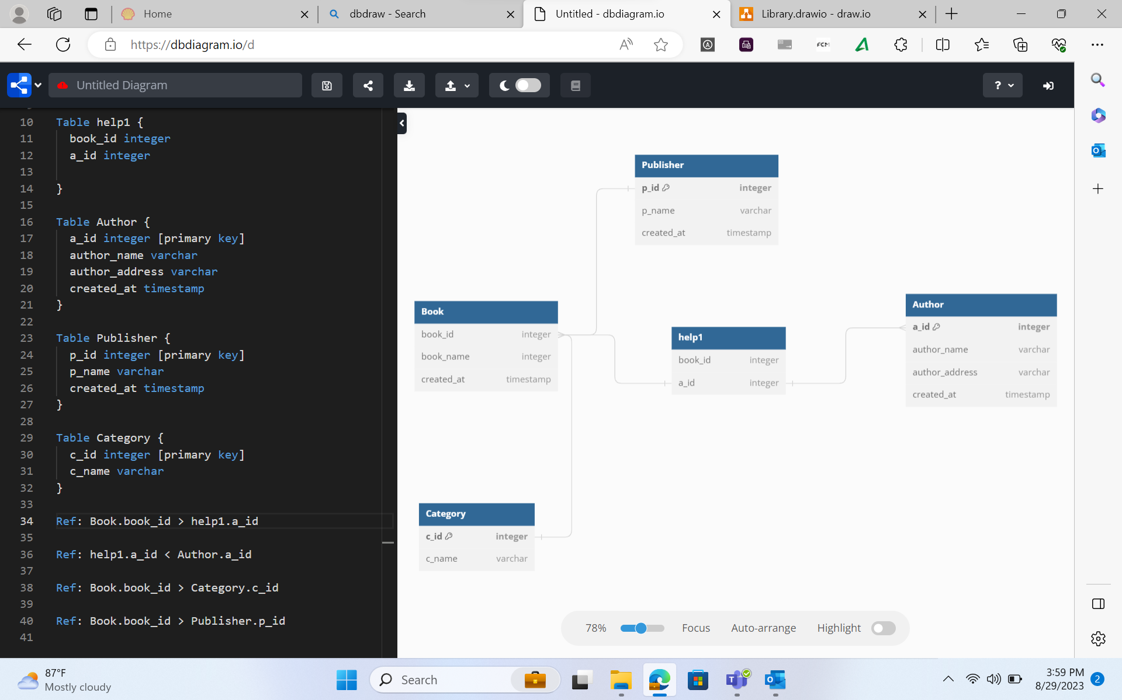
Day 2: Library Database designing

Slide 5
Day 3: Working on Azure SQL Database
Creating to Azure Virtual Machine
Connecting to Azure SQL Database
Creating simple tables and exploring DDL,DML,DQL commands
Creating database and working on SQL queries
Understanding Big Data, Hadoop and Data lakes
Understanding types of Non- relational databases
Understanding Key-value database, Document Based database, Wide-columnar database, Graph-based database

Slide 6
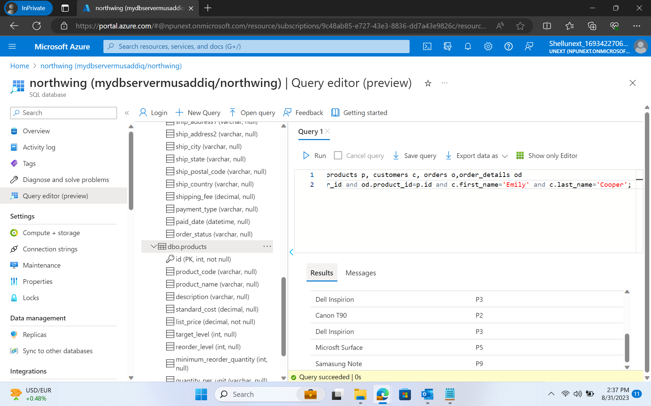
Day 3: Azure SQL

Slide 7
Day 4: Queries cont..
SQL queries like JOINS, UNION were explored
Further queries including like GROUP BY, ORDER BY were also explored
Nested queries: Some of the queries were designed to understand the working of the nested queries
The extension of this co-related nested queries were also explored
Writing queries without using nested queries and using JOINS like LEFT OUTER JOIN and RIGHT OUTER JOIN were explored

Slide 8
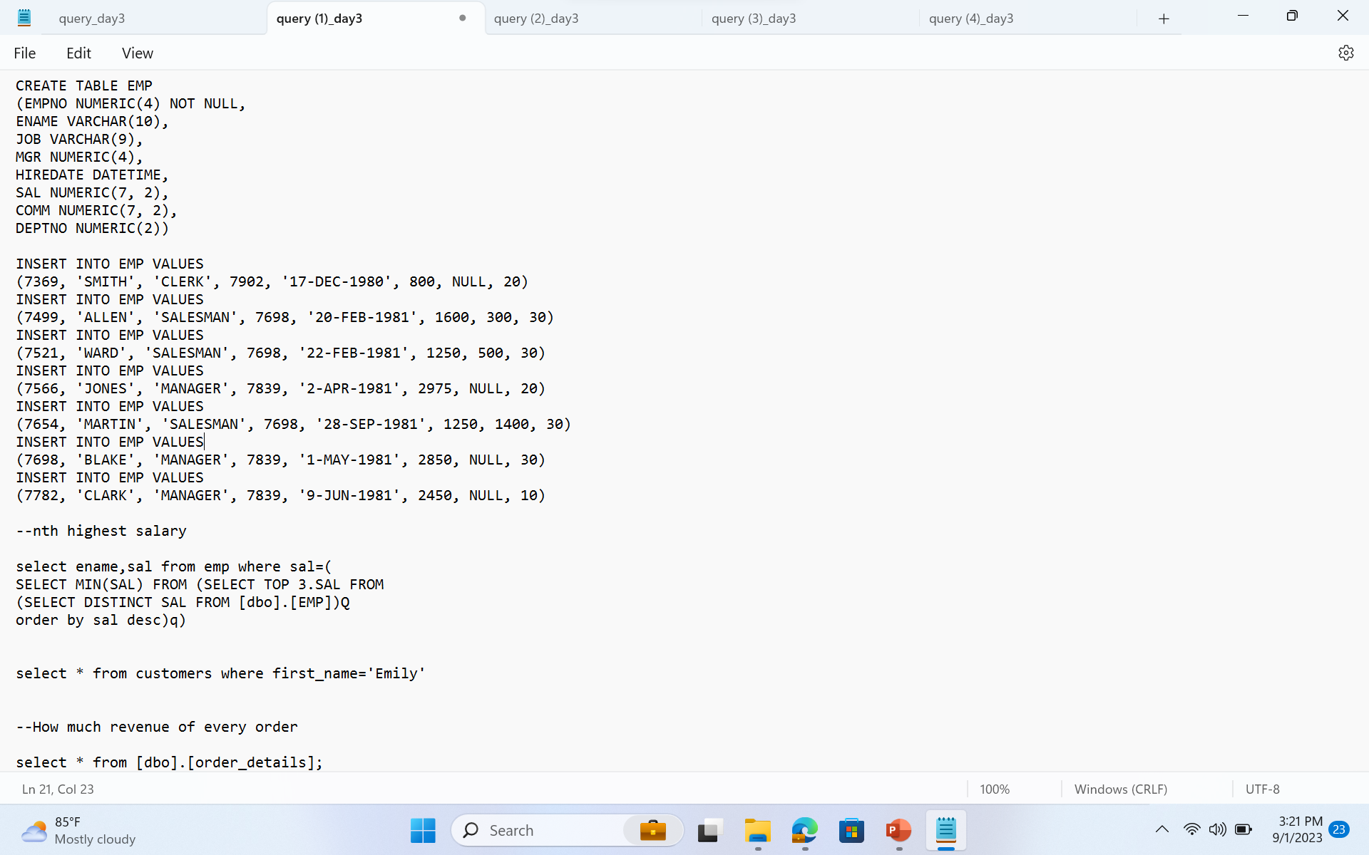
Queries

Slide 9
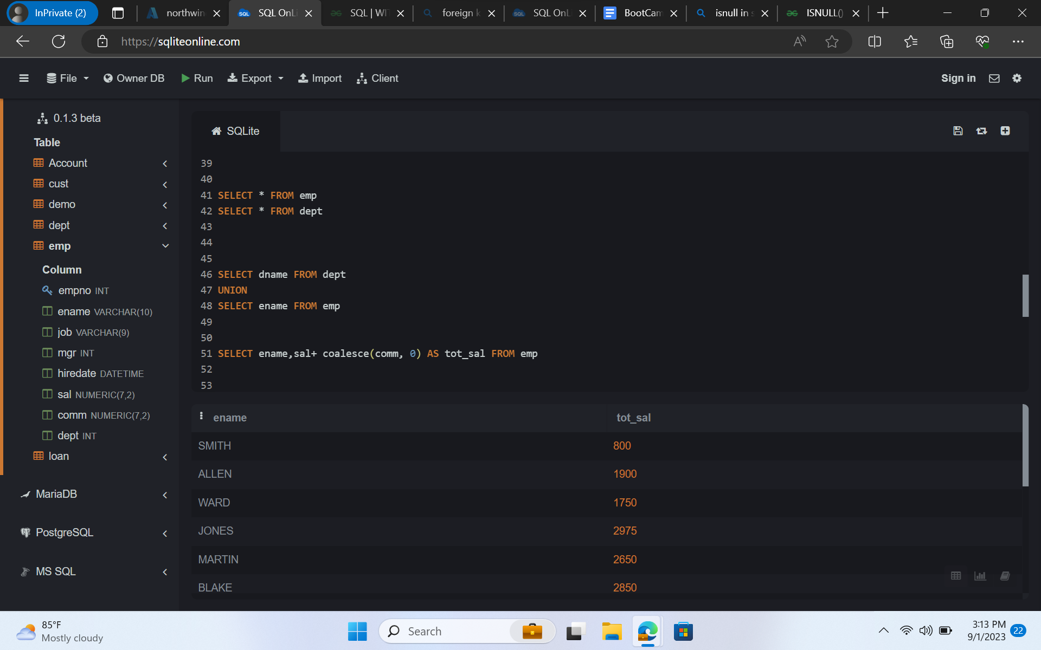
Queries

